Slide 1
CS50's Introduction to Game Development
Assignment 0 Demo
Stefano Lantaré

Slide 2
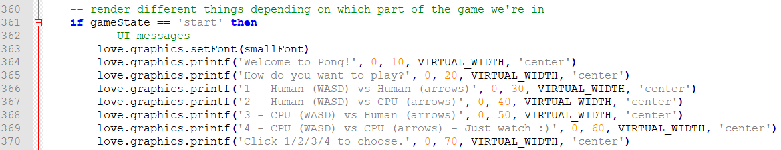
Choice before play 1/3 main.lua
Function love.draw
Modified the state start to choose the play mode.

Slide 3
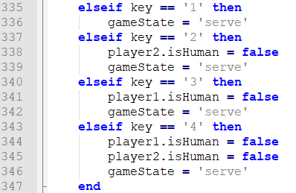
Choice before play 2/3 main.lua
Function love.keypressed
Managed the keys used to choose the play mode.

Slide 4
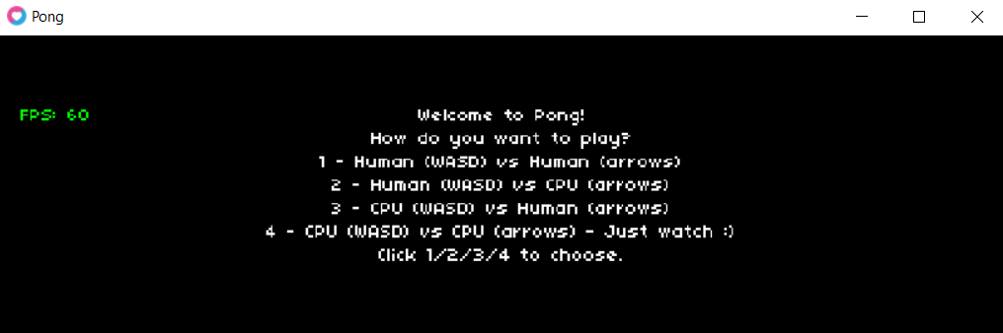
Choice before play 3/3 LOVE

Slide 5
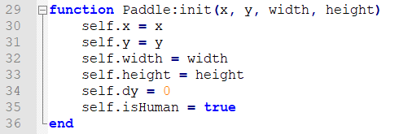
Is the player human? Paddle.lua
Function init
Inserted the new attribute isHuman to define if a player is a Human or not.
Default is true.

Slide 6
AI for paddles 1/2 main.lua
Function love.update
After the ball update, inserted the logic for AI-controlled paddles.
The AI paddle moves, following the ball direction, in these two situations
The ball is totally below the paddle
AND
The ball is going down
The ball is totally above the paddle
AND
The ball is going up

Slide 7
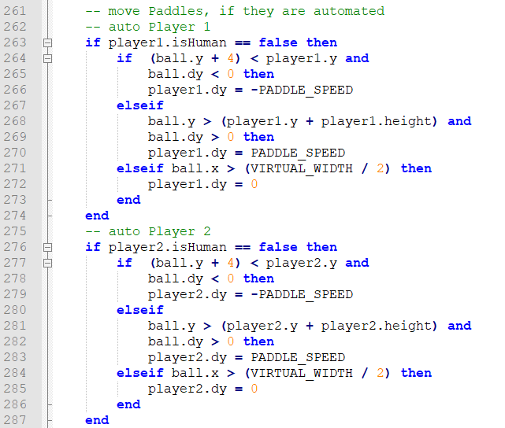
AI for paddles 2/2 main.lua
Function love.update

Slide 8
THANK YOU FOR WATCHING ☺

